Slide 1
WELCOME
WE ARE NICE TO HAVE YOU

Slide 2



VELTECH RANGA SANKU ARTS COLLEGE
AVADI, CHENNAI-600062
(Affiliated to University of Madras)
GYM MANAGEMENT SYSTEM
DEPARTMENT OF COMPUTER SCIENCE
APRIL 2024

Slide 3

TEAM MEMBERS
SANJAY . R - 222107591
MANOGARAN . R - 222107573
SAKTHIVEL . R - 222107588
GUIDED BY – Mrs. N.CHAMUNDEESWARI
(Head of the department)

Slide 4
ABSTRACT
GYM MANAGEMENT – WEB APPLICATION is a robust and user-friendly web application designed to streamline and enhance the management of fitness centers and gyms. The system aims to automate key aspects of gym operations, including member management, fee tracking, trainer allocation, and activity monitoring. By leveraging modern web technologies, GYM MANAGEMENT offers a seamless and efficient solution for both gym administrators and members. It is the ideal solution for gym owners looking to modernize their operations, improve member satisfaction, and optimize resource allocation. With its user-friendly interface and comprehensive feature set, It sets a new standard for gym management systems, ensuring a seamless experience for both administrators and gym enthusiasts

Slide 5
Hardware and Software Requirements
Hardware Specification
Device Used: LAPTOP (Lenovo x64-based processor)
Processor: AMD PRO A4-4350B R4 COMPUTE CORES 2C + 3G 2.50 GHz
Memory
Primary: 4.00 GB RAM (3.84 GB Usable)
Secondary: 500 GB Hard Disk Drive (465.76 GB Usable)
Software Specification
Operating System: Windows 10 Pro
Front end: PHP, HTML, CSS, JavaScript.
Back end: MySQL Server

Slide 6




PROGRAMS USED FOR THIS APPLICATION
FRONTEND
BACKEND

Slide 7
MODULES
1. Admin (11)
2. Guest (Viewer, Unregistered Users)

Slide 8
Sub Modules of Admin
Login
Dashboard
Member
Add member
Manage member
Payment
Health status
Plan
New plan
Edit subscription plan
Overview
Member per month
Member per year
Income per month
Exercise routine
Add routine
Edit routine
View routine
Change password

Slide 9
Steps of Testing
Unit Testing
Integration Testing
Acceptance Testing

Slide 10
Unit Testing
Unit testing means testing each units of design separately. Here in this project, we tested each unit of design separately and verify that there were no errors. For this testing each design is run individually After executing each page if there any error occurs correction mechanism is done instantly.

Slide 11
Integration Testing
In our project we combine many units module to form a sub system. These sub systems are then tested. This is done to see whether the modules can be integrated properly. Based on integration testing some changes made to the design.

Slide 12
Acceptance Testing
The goal of acceptance testing is to see if the software meets all the requirements as needed. The testing was performed by data of all the users of the system. It was found that the software meets all the requirements of the students, teachers, administrator and placement officer as needed.

Slide 13
DIAGRAMS

Slide 14
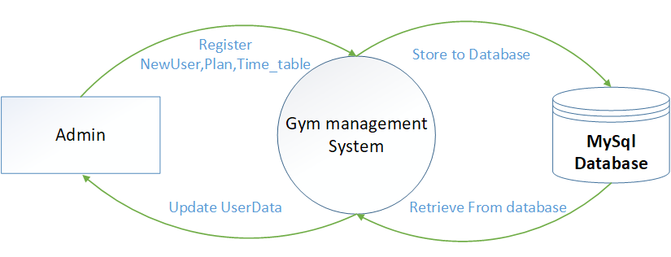
DATA FLOW DIAGRAMS
DFD: LEVEL 0

Slide 15
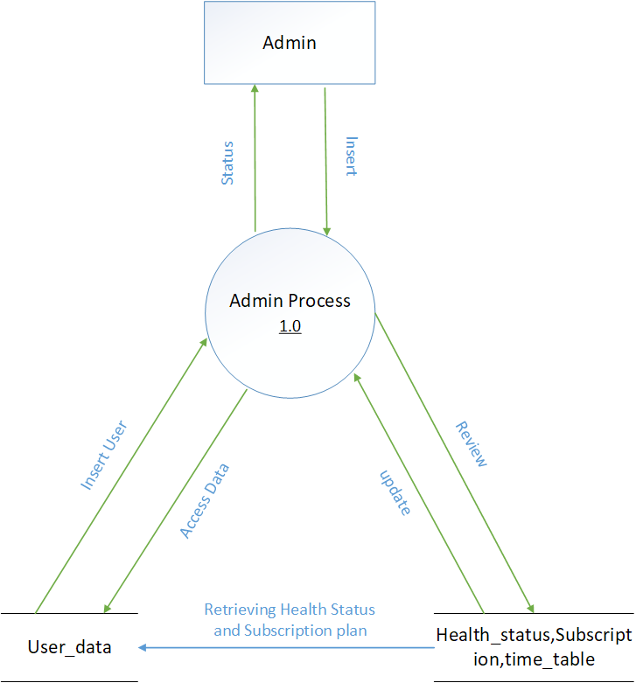
DFD: LEVEL 1
ADMIN PROCESSES

Slide 16
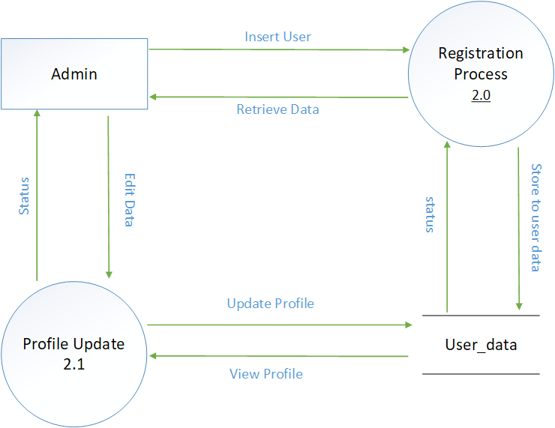
METHODOLOGY OF THE APPLICATION

Slide 17
SCREEN SHOTS

Slide 18
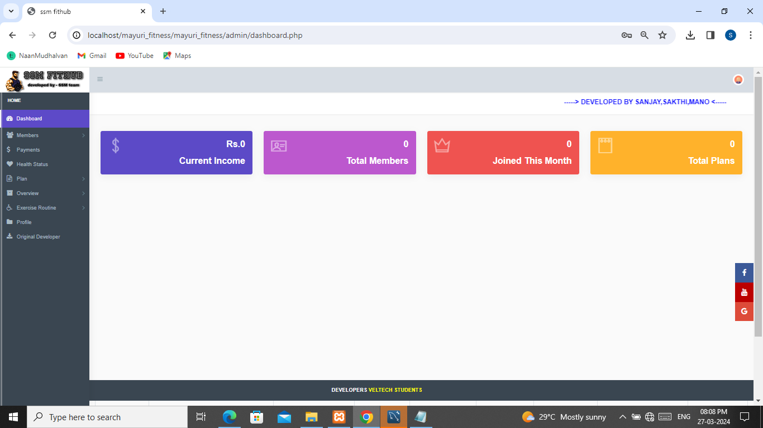
HOMEPAGE

Slide 19
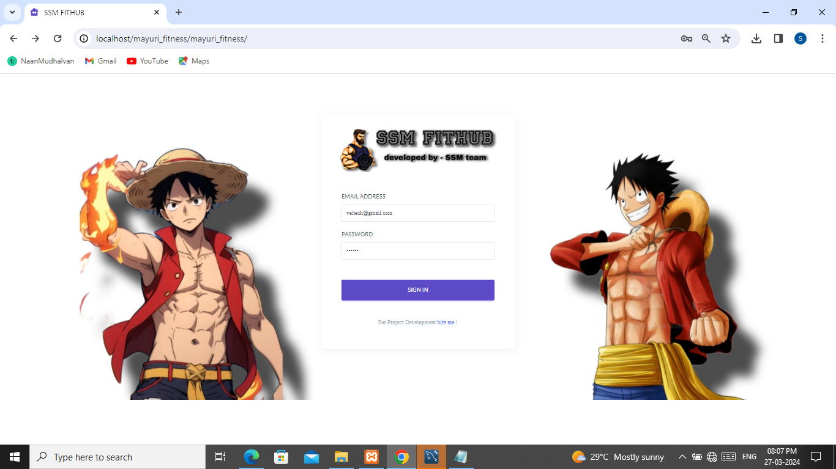
SIGN UP AND LOGIN

Slide 20
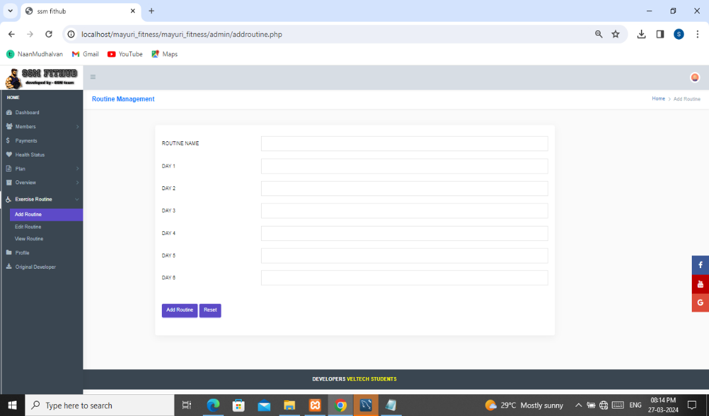
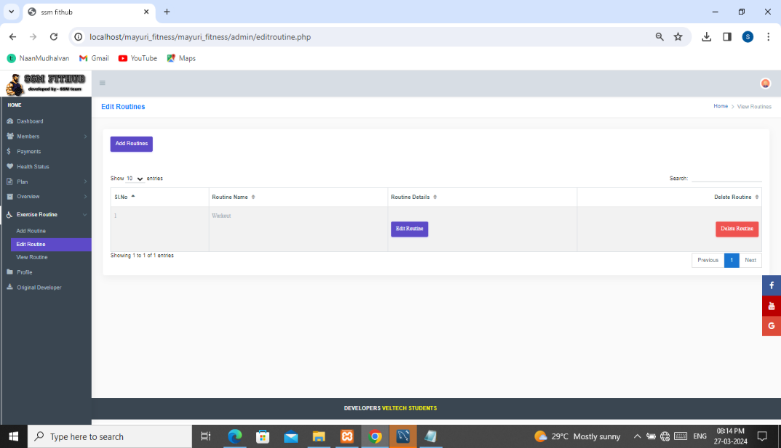
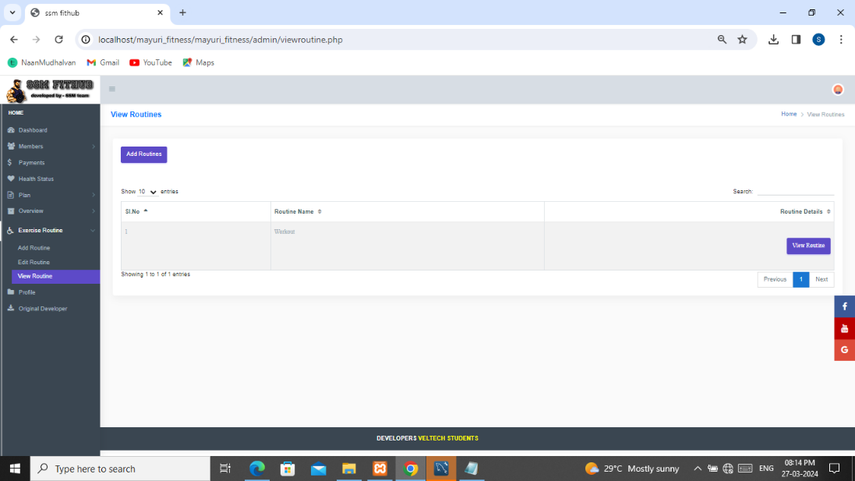
EXERCISE ROUTINE OF MEMBERS

Slide 21
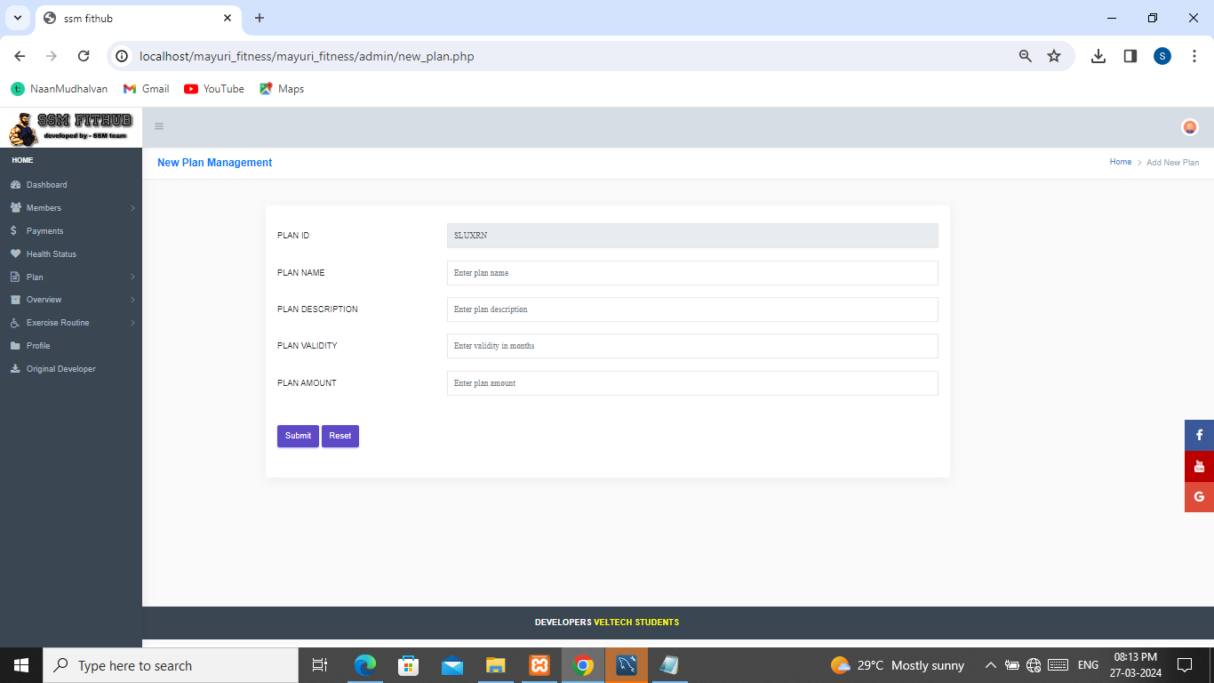
PLANS AND PACKAGE

Slide 22
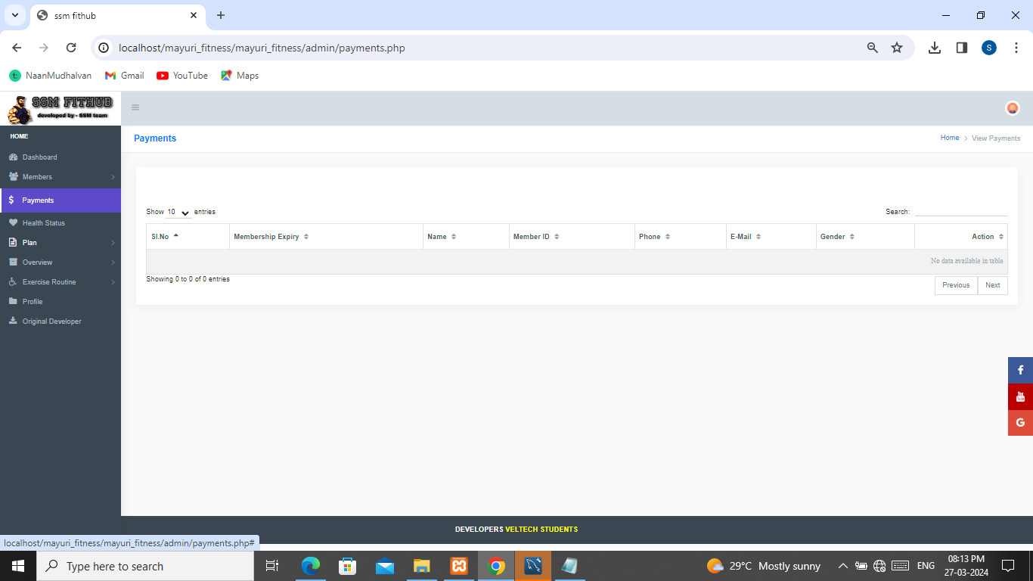
PAYMENTS DETAIL

Slide 23

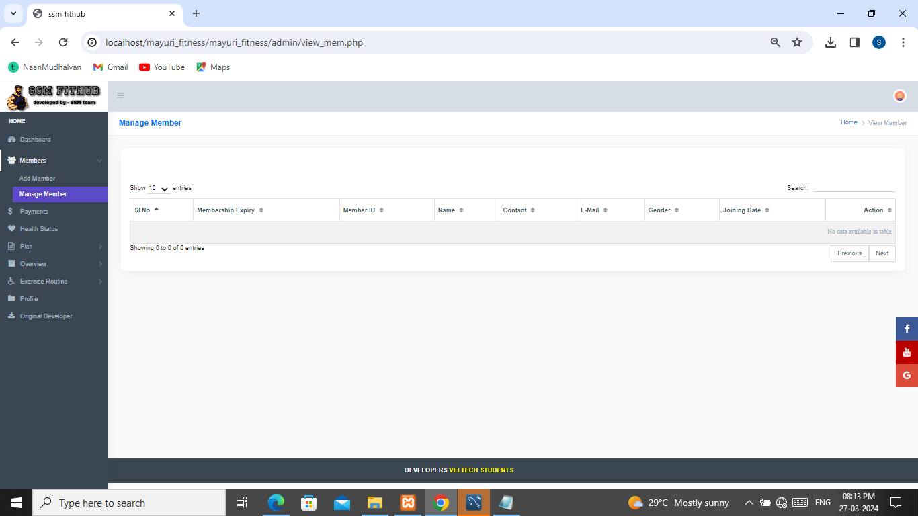
MEMBERS

Slide 24
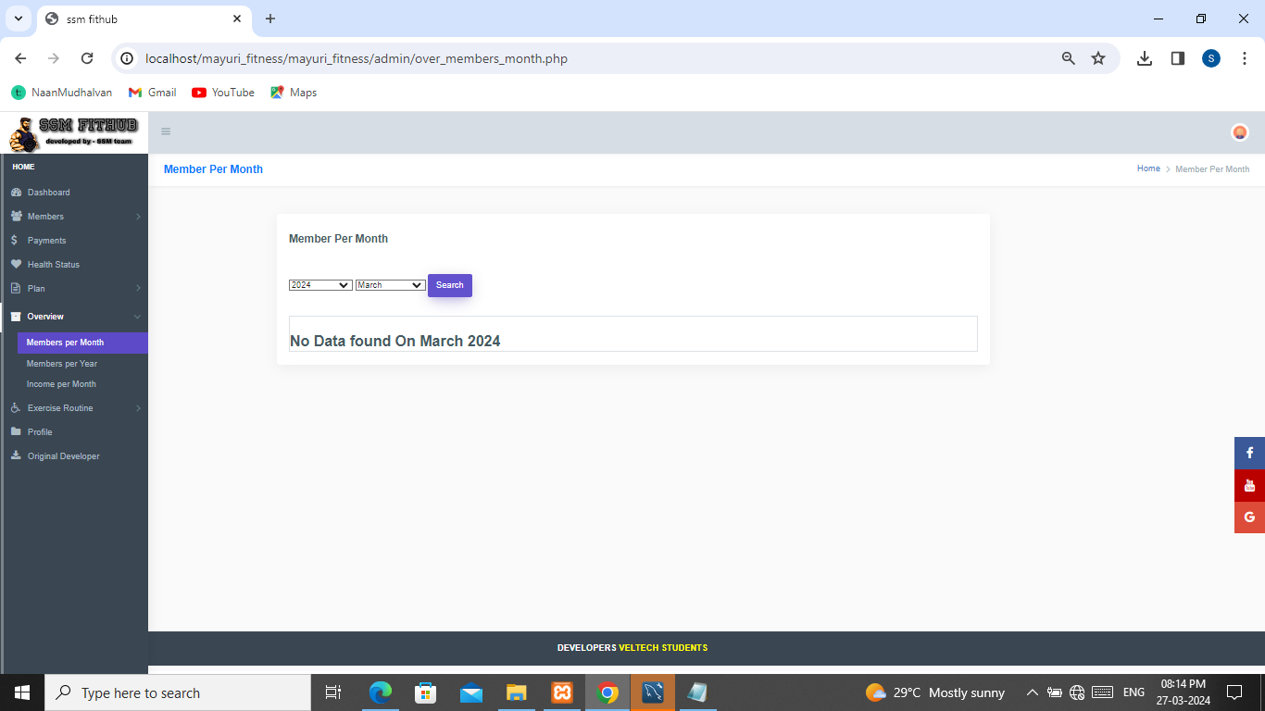
OVERVIEW

Slide 25

HEALTH STATUS OF MEMBER

Slide 26
CONCLUSION
This project was successfully completed, within the time span allotted. All the modules are tested separately and input together to form the main system. Finally, the system is tested with real data and everything worked successfully. Thus, the system has fulfilled the entire objective identified. The system had been developed in an attractive dialogue fashion. So, the user with minimum awareness about computers can also operate our site easily.

Slide 27
FUTURE WORKS
In future, our project will be able to access through the Internet. So that, many of the people can be use our website connectively for their purposes. And then, the drawback of our project which is that the payment transaction will be sorted out.

Slide 28
QUERIES ?

Slide 29
THANK YOU
FOR YOUR PATIENCE

